Slide 1
Skidby 10 mile Time Trial Saturday 23rd March First rider starts at 2.01 Skidby Village Hall Organised for and on behalf of cycling time trials under their rules and regulations.

Slide 2
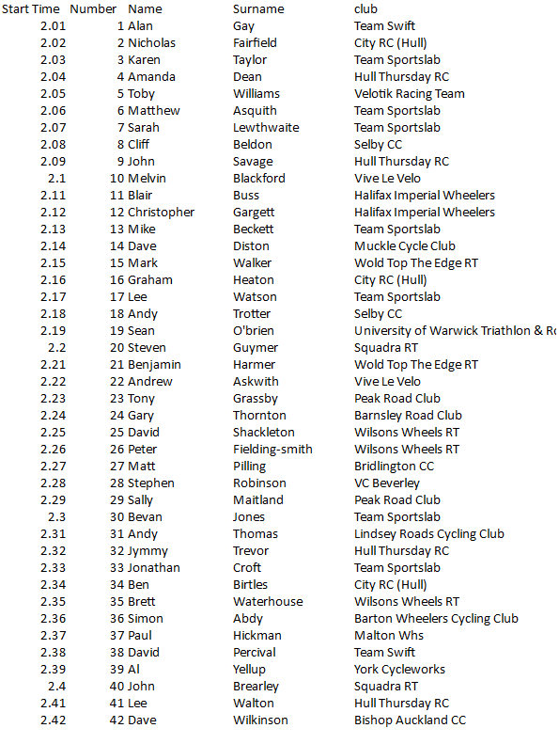
Sportslab Time Trial
HQ – Skidby Village Hall
Numbers, toilets, result board and most importantly tea & cake will be available from 1pm
Parking
Please note there is no parking facilities at the village hall. Please park on Riplingham Road (The small road near the start).
Sign In
Riders are required to sign in when collecting their number.
Sign Out
Riders are required to sign out when leaving their number.
Course
A map of the course can be seen on the following page.
Presentation
Presentation will be made in the hall at approx 4pm

Slide 3
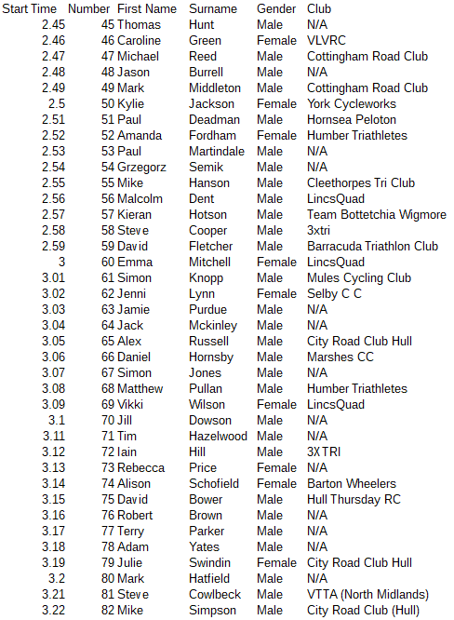
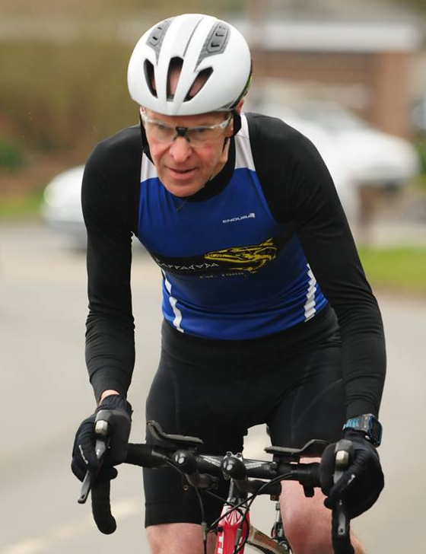
Come & Try It Event
Time Trial Etiquette
Riders are set off at one min intervals and aim to complete the course as quickly as they can. Your time is worked out by the finish timekeeper and displayed on the result board in the HQ
If you are caught by another rider, or if you catch another rider, you are not allowed to ride together (or draft in their slipstream).
You must stick to the rules of the road and the highway code. Marshalls and signs are used to direct you around the course but the roads are still open to traffic in the usual way.

Slide 4
Prizes, Course & Time Trial Etiquette.
The course can be found by clicking onto this link.
https://www.mapmyride.com/routes/view/1907048855
Prizes:
1st Male 1st Female
2nd Male 2nd Female
3rd Male 3rd Female
Fastest Male on a traditional road bike
Fastest Female on a traditional road bike
1st Male Team (combined time of three riders from the same club)
1st Female Team
Spirit award
Prize presentation will take place in the HQ at 4pm
V763
START ON RIPLINGHAM ROAD SKIDBY, APPROX 30 METERS FROM ROAD JUNCTION JADACENT TO STREET LAMP PROCEED TO JUNCTION TURN LEFT ON TO WHITE GAP ROAD TO LITTLE WEIGHTON
STRAIGHT ON (1.9 MILES) TO CROSS ROADS( 2.94) STRAIGHT ON TO T JUNCTION WITH BRICK DIKE LANE
LEFT (3.97 MILES). PROCEED TO NEXT X ROADS (4.82) STRAIGHT ON TO RIPLINGHAM CROSS ROADS (5.9 MILES) LEFT (CAUTION) DIRECTION HULL. CONTINUE TO RAYWELL HOUSE & JUST AFTER BARE LEFT AT SLIP ROAD IN THE DIRECTION OF COTTINGHAM (8.03). CONTINUE THROUGH EPPLEWORTH & LEFT AT JUNCTION PRIOR TO A164 UNDERPASS & UP SKIDBY HILL, PROCEED UP SKIDBY HILL TO FINISH AT PAINT MARK IN ROAD ADJACENT SKIDBY MILL CAR PARK (10.70 MILES)
Please remember to return your number after the event.

